Slide 1
Beautiful C++: Chapter 3.2 I.3: Avoid Singletons
Slides by: Yenzo Devos, Finian Horrie, Siebe Boeckx
Presented by: Viktor Mendonck

Slide 2
Global Objects
“Global objects are bad, m’kay” – G. Davidson
No access restrictions
Program is the owner, object lives through program (static)
Problematic!
Ownership fundamental to reason about objects
How do we know its state?
No idea of construction order
We need a solution…
Notes:
Static -> constructed at startup, destroyed at shutdown

Slide 3
Singleton Design Pattern
Creational pattern
Only make one instance something
Characterized by name “Manager”
Ownership decision problems
Prone to “Static initialization order fiasco”
Circular dependencies among global objects

Slide 4
Order of global construction
“Can we tell the linker what order global objects should be constructed?”
Has been tried
Not standard C++
“Why not standardize?”
Easy to hurt yourself with global static object dependencies
Static object initialization is specified by order of declaration, per translation unit
Linkers need to support this as well
“A fool's errand”

Slide 5
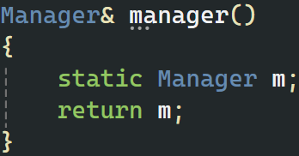
How to fix?
Take your objects out of the global name space
Allow for scheduling of initialization
“Meyers Singleton”
Manager object is created after function call
Static data in local scope has different init rules
Initialization issues when multithreading?
Thread safe (C++11)

Slide 6
Didn’t you just hide the singleton?
Well, yes
Hiding singletons is easy
Enforcing non-use is very hard
Rat out the singletons
Classes that contain the name “singleton”
Classes that instantiate a single object
Consider this code snippet

Slide 7
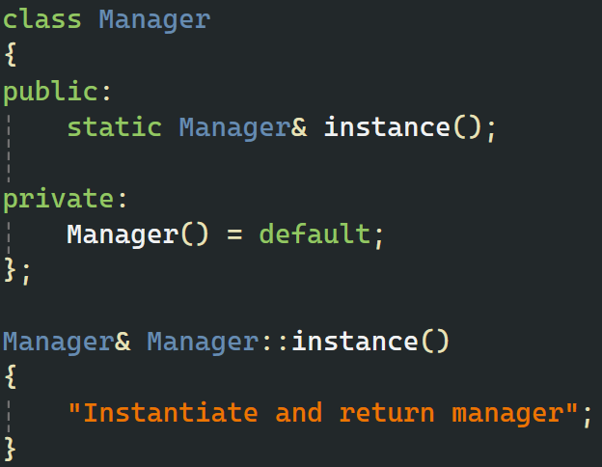
Is this a singleton?
The main giveaway is the private constructor
Only a member or a friend can instantiate
We see no friend declarations
Member function which returns a Manager&!
100% Singleton
“Should we avoid all static storage duration objects?”
Hold that thought

Slide 8
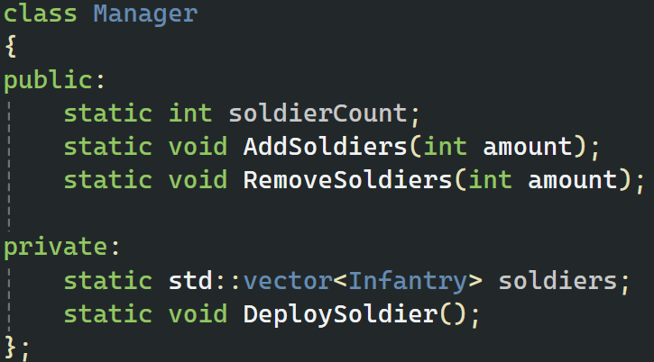
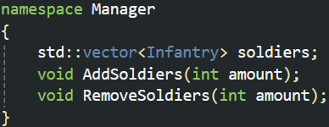
singletons, not Singletons
A class with static data and member functions
Why though?
Overly convoluted
Put it in a namespace
Does not need to be exposed
It can be hidden in an implementation file
Might still be prone to SIOF
Static initialization order fiasco

Slide 9
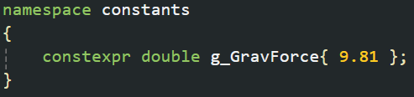
Isn’t this just a singleton
Well, it is, but that’s not a bad thing
“Avoid Singletons”, the pattern
We still allow single-instance abstractions
Not all static memory falls under “Singleton”
Const global memory is fine (preferred in namespace)

Slide 10
Conclusion
Avoid singletons: the pattern, not the abstraction.
Not all global data is bad, only when it’s mutable
Prefer using a namespace over a class to model this type of abstraction.

Slide 11
Summary [154 < 160char]
“Avoid the Singleton pattern. Put single-instance abstractions in a namespace. Pay attention when working with global memory, prevent circular dependencies”

Slide 12
Questions
What is the difference between Singleton and a singleton?
What does SIOF refer to (Static Initialization Order Fiasco)?
Is global memory always bad? Why?
Why isn’t dictating the order of construction for global variables standardized?
Notes:
Singleton is the pattern that ensures a class only has one instance and provides an access point to that instance
singleton refers to a single-instance abstraction.
SIOF = Static Initialzation Order Fiasco
The order where static variable are initialized is not set, so when one static variables are dependent on each other, it can cause undefined behavior and even crashes.
No, only global mutable memory is bad. Constant data can be safely declared globally, preferably in a namespace
Setting the order of declaration for global memory would require all Linkers to accommodate for this feature.
It is also not bulletproof cause you can still cause circular dependencies with this system.

